Slide 1
4 Design patterns

Slide 2
Main concepts to be covered
Why design patterns matters
Classification of patterns
Some common patterns
  Composite
  Decorator
  Singleton
  Factory method
  Observer
Notes:
Viktigt att känna till fenomenet.
Kräver fördjupning
Tar några representativa fall som går
att förklara med små exempel.
Andra kräver större exempel.
Spelprogram

Slide 3
Why design patterns matters
Inter-class relationships are important, and can be complex.
Some relationships recur in different applications.
Design patterns help clarify relationships, and promote reuse.
Don’t reinvent the wheel!

Slide 4
Small and large Patterns
Architectural patterns (large scale)
Design patterns (medium scale)
Idioms (small scale)
Notes:
Alla är designmönster men vi avser medium i fortsättningen

Slide 5
Architectural Pattern
Fundamental structural organization template for a whole software system.
It provides
  a set of predefined subsystems
  responsibilities of subsystems
  relationships between subsystems
Example Model View Controller

Slide 6
Design pattern
Medium scale organization scheme for components of a software system.
It provides
  a scheme for refining components and their relationships.
  communication rules for cooperating components.
It is independent of programming language.
Example Observer
Notes:
Renodla roller – KOHESION.
Minska KOPPLING.
I princip oberoende av paradigm (OOP)

Slide 7
Idiom
Low level design pattern.
Programming language specific implementation techniques.
Example: The string copy loop idiom for the C/C++ programming language
  while ((*t++ = *s++) != ’\0’) ;
Notes:
Idiom = språkuttryck

Slide 8
Design pattern categories
Creational patterns: Object creation.
  Singleton, Factory, Abstract Factory, Factory Method, ...
Structural patterns: Static composition.
  Composite, Decorator, Adapter, ...
Behavioral patterns: Dynamic object interaction.
  Iterator, Command, State, Template Method, Strategy, ...
Notes:
Factory relevant för speldesign
Iterator är även relaterat till
Factory-mönstren

Slide 9
Design pattern description
A design pattern description consists of
Pattern name.
Category:
  Creational, Structural, or behavioral.
Intent:
  The problem addressed by it.
Structure:
  Class diagram showing participants and relationships.
Participants:
  A list of participating classes or objects and their collaboration.
Applicability:
  Situations in which it is useful.
Its consequences:
  Results, trade-offs.
Notes:
Lite mindre stringent i fortsättningen

Slide 10
Composite
Composite defines a part-whole relationship between objects in a tree hierarchy.
Simple objects and composite objects can be treated uniformly by clients
  uniformly with respect to their common interface.
Notes:
Strukturellt mönster

Slide 11
Composite (2)
Example instances:
Component, Container, JPanel, JButton,...
Hierarchical file systems have two kinds of files
  “Ordinary” files (Leaf) contain data.
  Directories (Composite) contain files.

Slide 12
An instance of Composite:
Hierarchical file systems
A directory is a file that contains
other files
root
f1
subdir1
subdir2
subdir3
f2
f3
f4
f5
f6
f7
f8

Slide 13
A file system
Explore the
file_system
project
<<abstract>>
File
*
Client
getSize()
getName()
print()
contents
TextFile
Directory
getSize()
write(s:String)
append(s:String)
read():String
getSize()
print()
add(x:File)
remove(x:File)
getChild(i:int):File
1
Notes:
File:
getSize() impl. Av subklasserna
getName()
print() har defualtimpl. Här
TextFile:
Ärver print()
Impl. getSize()
Directory:
Impl. getSize(), överskuggar print()
Övr. ops utanför interfacet

Slide 14
Another instance of Composite:
Hierarchical geometrical shapes
A group of shapes
is a shape too ...
A shape
A shape
A shape
... so a group can be a part of another group

Slide 15
Geometrical shapes
<<abstract>>
Shape
*
Client
draw()
erase()
reSize(x:int,y:int)
move(dx:int,dy:int)
parts
Rectangle
Ellipse
Group
draw()
erase()
reSize(x:int,y:int)
move(dx:int,dy:int)
draw()
erase()
reSize(x:int,y:int)
move(dx:int,dy:int)
draw()
erase()
reSize(x:int,y:int)
move(dx:int,dy:int)
add(s:Shape)
1
Notes:
Övn. Lägg till instansvariabler och clone()!

Slide 16
General Composite Pattern
Participating classes:
  Component (abstract class)
    declares common operations and default behavior.
  Leaf (“base case”)
    implements behavior for the primitive elements in the composition.
  Composite (“recursion”)
    manages child components.
  Client
    manipulates objects in the composition via the Component interface.

Slide 17
General Composite Pattern
<<abstract>>
Component
*
Client
operation()
add(x:Component)
remove(x:Component)
getChild(i:int):Component
children
Leaf
Composite
operation()
operation()
add(x:Component)
remove(x:Component)
getChild(i:int):Component
1
Notes:
Generellt schema.
Anpassa för situationen i fråga.
Man kan ha flera olika typer av lövklasser
Operation() repr. En eller flera ops som måste implementeras av subklasserna
Add, remove, getChild, … har defaultimpl. I basklassen

Slide 18
Decorator
Augments the functionality of an object.
Decorator object wraps another object.
  The Decorator object has a similar interface.
  Calls are relayed to the wrapped object ...
  ... but the Decorator can interpolate additional actions.
Example: java.io.BufferedReader
  Wraps and augments an unbuffered Reader object.
Notes:
Strukturellt mönster.
Jämför med arv: statisk utvidgning vs dynamisk
Arv: Adderar ny egenskap till alla objekt av subklassen.
Decorator kan berika ett individuellt objekt – temporärt om så önskas.
Flera decoratorer kan dela samma objekt

Slide 19
Extension by inheritance
<<interface>>
Int
operation()
newOperation() is implemented in exactly the same way in all the new classes => CODE DUPLICATION!
Class_1
Class_2
Class_n
...
operation()
operation()
operation()
NewClass_1
NewClass_2
...
NewClass_n
newOperation()
newOperation()
newOperation()
Notes:
Man vill lägga till en egenskap till ett
antal givna klasser.
Det går kanske inte att definiera detta i
en basklass till klasserna.
Om man skulle använda arv skulle det
bli en subklass för varje kombination –
med samma implementering =
kodduplicering!
Många kombinationer
=> Många subklasser

Slide 20
Extension using Decorator pattern
<<interface>>
Int
1
operation()
delegate
Class_1
Class_n
NewClass
operation()
...
operation()
- obj : Int
+ <<create>>NewClass(obj:Int)
operation()
newOperation()
1
Notes:
operation(): sådana ops som alla har
newOperation(): tillskottet

Slide 21
Example: Number generator
<<interface>>
NumberGenerator
Static inheritance version
Explore the
decorator1
project
computeNext()
reset()
getValue()
PrimeGenerator
FibonacciGenerator
computeNext()
reset()
getValue()
computeNext()
reset()
getValue()
Return an array with the next n numbers
BufferedPrimeGenerator
BufferedFibonacciGenerator
getSequence(n:int):long[]
getSequence(n:int):long[]
Notes:
Nu utan Observer och MVC
Decorator1 – namnet missvisande eftersom v inte använder Decorator här.

Slide 22
Decorated NumberGenerator
<<interface>>
NumberGenerator
1
computeNext()
reset()
getValue()
Explore the
decorator2
project
delegate
PrimeGenerator
BufferedNumberGenerator
computeNext()
reset()
getValue()
- obj : NumberGenerator
+ <<create>> BufferedNumberGenerator
(obj:NumberGenerator)
computeNext()
reset()
getValue()
getSequence(n:int):long[]
1
FibonacciGenerator
computeNext()
reset()
getValue()
Notes:
Arv vs aggregation …

Slide 23
Using the BufferedNumberGenerator
FibonacciGenerator
1,1,2,3,...
BufferedNumberGenerator
{1,1,2,3,5,8,13,21,34,55}
Client
Notes:
Mönstrets namn
Filter -- egenskaper
Decorator ++egenskaper

Slide 24
Using the BufferedNumberGenerator
BufferedNumberGenerator bp =
new BufferedNumberGenerator(new PrimeGenerator());
BufferedNumberGenerator bf =
new BufferedNumberGenerator(new FibonacciGenerator());
...
bp.computeNext();
long x = bp.getvalue();
...
bp.reset();
long[] array = bp.getSequence(10);
{2,3,5,7,11,13,17,19,23,29}
NumberGenerator methods
work for buffered generators too

Slide 25
Java implementation
public class BufferedNumberGenerator implements NumberGenerator {
private NumberGenerator decoratedObject;
public BufferedNumberGenerator(NumberGenerator decoratedObject) {
this.decoratedObject = decoratedObject;
}
public void computeNext() { decoratedObject.computeNext(); }
public void reset() { decoratedObject.reset(); }
public long getValue() { return decoratedObject.getValue(); }
public long[] getSequence(int n) {
long[] numArray = new long[n];
for ( int i = 0; i < n; i++ ) {
numArray[i] = decoratedObject.getValue();
decoratedObject.computeNext();
}
return numArray;
}
}
Delegation
New

Slide 26
Singleton
Ensures only a single instance of a class exists.
  All clients use the same object.
Constructor is private to prevent external instantiation.
Single instance obtained via a static getInstance method.
Example: Canvas in shapes project.
Notes:
Finns shapes … ?
Använd sparsamt?
Trådsäkert?
… finns papper om detta

Slide 27
Singleton
Java implementation template
public class Singleton {
private static Singleton instance = null;
// Private prevents external object creation
private Singleton() {}
// Return the single object of this class
// create (lazily) if necessary
public static synchronized Singleton getInstance() {
if ( instance == null )
instance = new Singleton();
return instance;
}
}

Slide 28
Singleton: an example
public class TicketMachine {
private static TicketMachine instance = null;
private int count;
// This forbids external object creation
private TicketMachine() { count = 0; }
// Return the single object of this class,
// create if necessary
public static synchronized TicketMachine getInstance() {
if ( instance == null )
instance = new TicketMachine();
return instance;
}
public synchronized int getTicket() {
return ++count;
}
}
Ticket numbers are guaranteed
to be unique as there can only
exist one object of this class.

Slide 29
Using the ticket machine
//Client 1
TicketMachine tm = TicketMachine.getInstance();
int ticket = tm.getTicket();
...
//Client 2
TicketMachine tm = TicketMachine.getInstance();
int ticket = tm.getTicket();
...
1,4,5,9,…
2,3,6,7,8,…
client1
tm
client2
Explore the
singleton
project
Notes:
C1 och C2 ser disjunkta talserier

Slide 30
Factory method
A creational pattern.
Clients require an object of a particular interface type or superclass type.
A factory method is free to return an implementing-class object or subclass object.
Exact type returned depends on context.
Example: iterator methods of the Collection classes.
Notes:
Skapa objekt utan new
new => statiskt bundet till typnamn – oflexibelt
Iterator enkelt exempel på Factory-mönstret
Se Abstract Factory m.fl.

Slide 31
Factory method (2)
Client
<<abstract>>
AbstractCollection
<<interface>>
Iterator
iterator()
hasNext()
next()
ConcreteCollection
Concrete_Iterator
iterator()
hasNext()
next()
creates
return new Concrete_Iterator(this)
Notes:
Konkreta iteratorer finns för alla itererbara standardklasser
Men man ser dem aldrig!
Olika lagringsstrukturer kräver förstås olika tekniker i iteratorklasserna.
t.ex. vid iterering i sökträd.
- Ofta deklareras iteratorklasserna internt och privat

Slide 32
Example: SimpleArrayList
<<abstract>>
SimpleAbstractList
<<interface>>
Iterator
iterator()
hasNext()
next()
SimpleArrayList
SimpleArrayListIterator
iterator()
hasNext()
next()
creates
return new SimpleArrayListIterator(this)
Notes:
Det finns fler operationer!

Slide 33
Example: SimpleArrayList (2)
: SimpleArrayListIterator
theList
current
5
: SimpleArrayList
array
0
1
2
3
4
5
6
7
8
9
size
8
: SimpleArrayListIterator
theList
current
2
Explore the
factory
project
Notes:
Om tid: kolla i impl.
- privat intern klass

Slide 34
Observer
Supports separation of internal model from a view of that model.
Observer defines a one-to-many relationship between objects.
The object-observed notifies all Observers of any state change.
Example SimulatorView in the foxes-and-rabbits project.
Notes:
En del av MVC

Slide 35
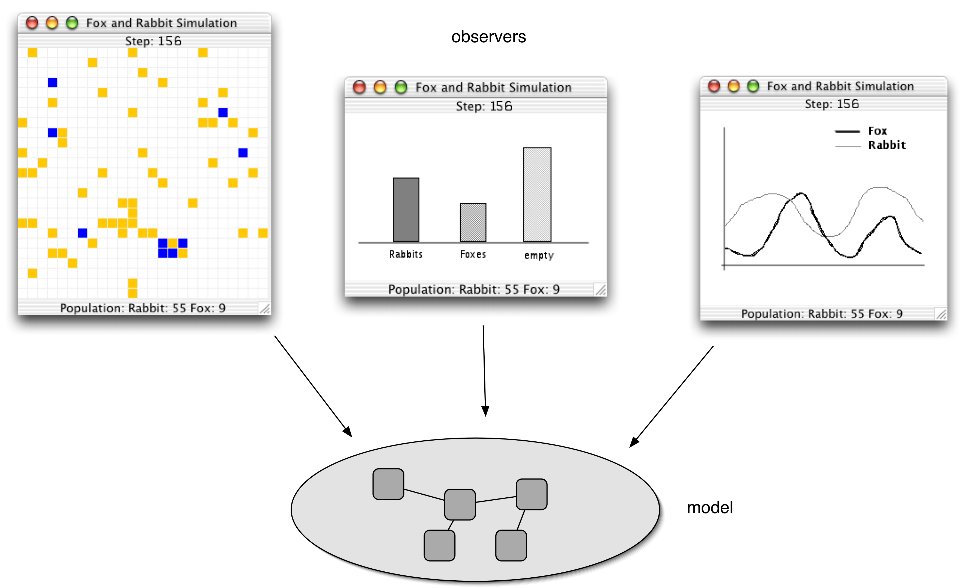
Observers

Slide 36
Review
Design flexible, extendible and maintainable class structures.
Being aware of existing design patterns will help you to do this.
Notes:
Spelprogram tacksamt tillämpningsområde.

